Slide 1
Writing expectations in KS2
Miss Vernon

Slide 2

Agenda
What is writing?
What does my child need to include?
How does this look in practice?

Slide 3
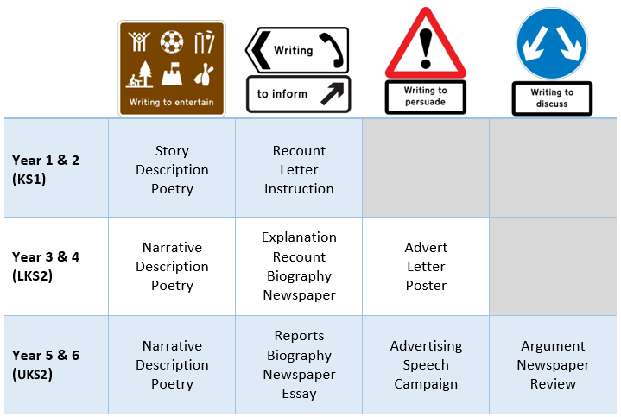

What is writing?

Slide 5
What is writing?
Within our writing lessons and journeys, we aim to include all the intended targeted skills required by the National Curriculum. These include:
Extend the range of sentences with more than one clause by using a wider range of conjunctions, including when, if, because, although
Use the present perfect form of verbs in contrast to the past tense
Choose nouns or pronouns appropriately for clarity and cohesion and to avoid repetition
Use conjunctions, adverbs and prepositions to express time and cause
Use fronted adverbials and commas after fronted adverbials
Indicate possession by using the possessive apostrophe with plural nouns
Use and punctuate direct speech
Use further prefixes and suffixes and understand how to add them
Spell further homophones and spell words that are often misspelt
Place the possessive apostrophe accurately in words with regular plurals and in words with irregular plurals
Use the first two or three letters of a word to check its spelling in a dictionary
Write from memory simple sentences, dictated by the teacher, that include words and punctuation taught so far

Slide 6
What does my child need to include?

Slide 7
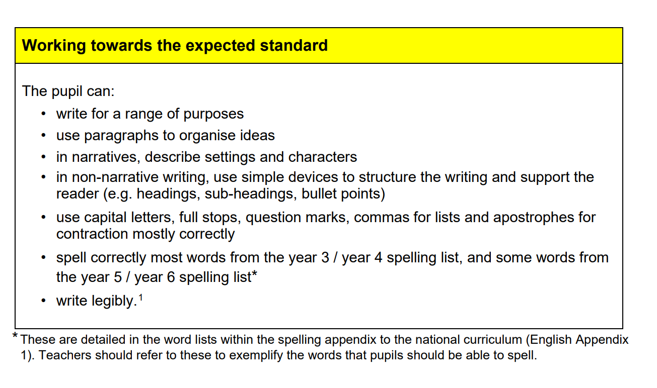

Slide 8
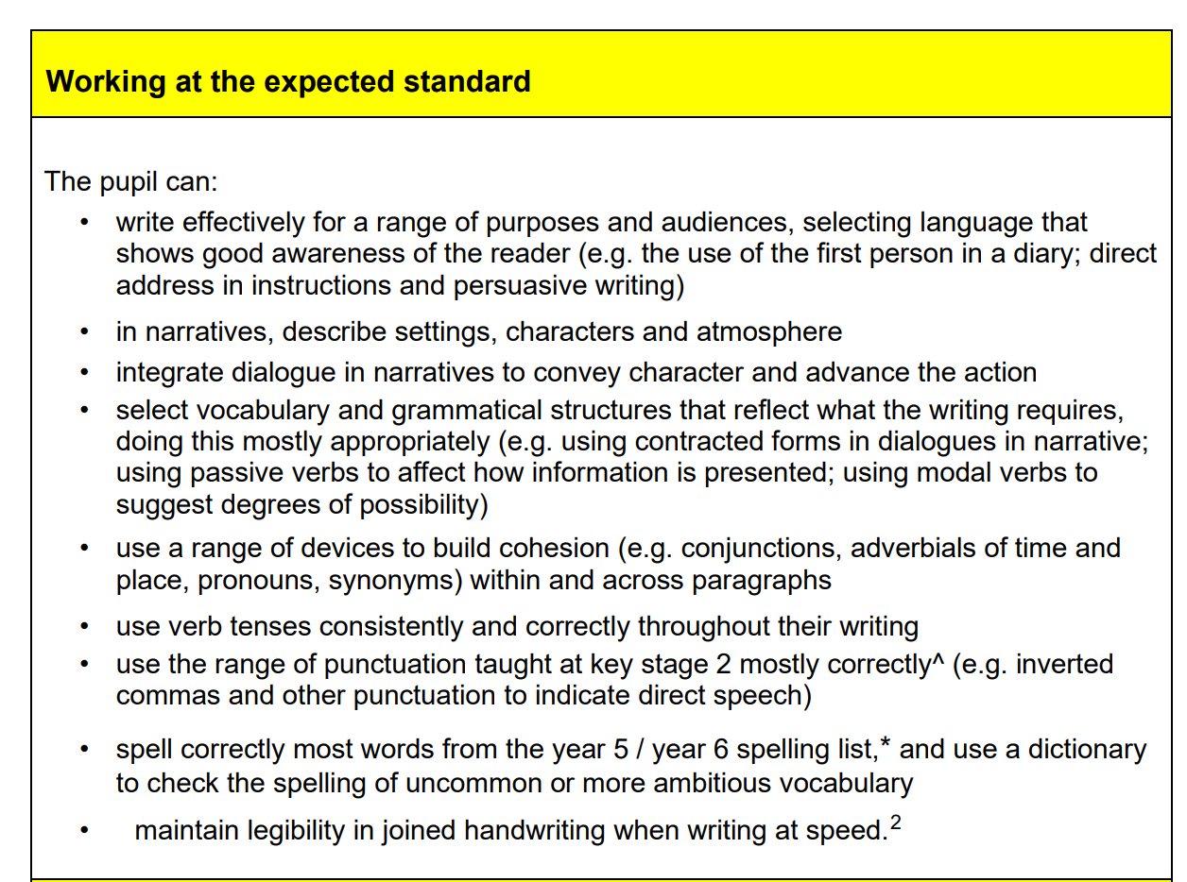

Slide 9
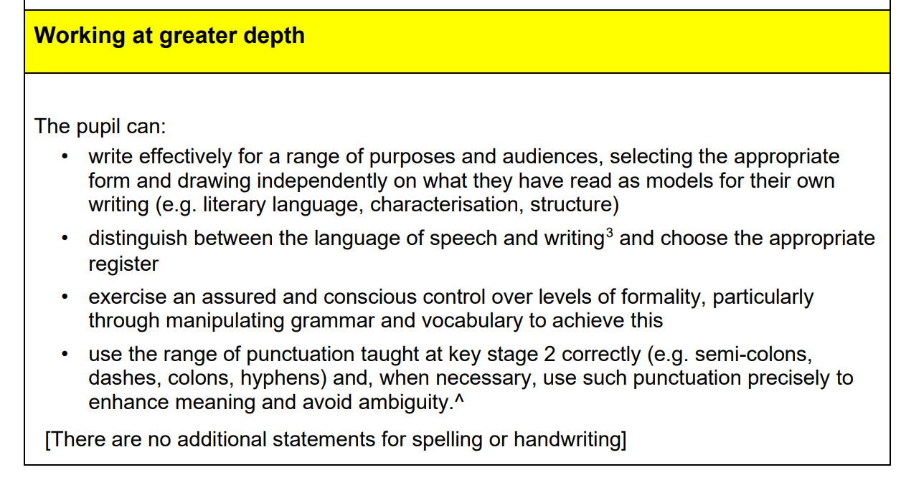

Slide 10
How does this look in practice?

Slide 11
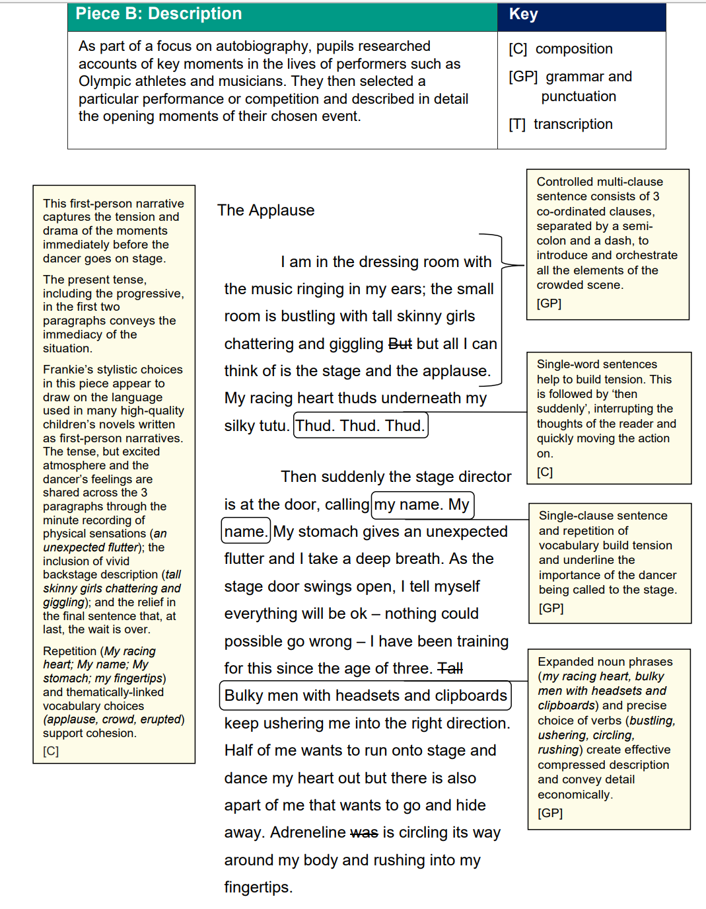
These are just some examples of how your child can include the skills needed to gain secure or mastery.
On the tables around you are a selection of Secure and Mastery level pieces of writing.

Slide 12

What do we do to help your child?
We give them a range of writing opportunities, based on texts that they have building their knowledge on.
We apply differentiation to support your child in their individual progression.
We offer support mats for spellings and sentence ideas.

Slide 13
Thank you
Any questions?

